Slide 1
Know Your Neighbour Application
Module Project
Module: Application Integration (API using Spring Boot & React JS)
Start Date : 11 May 2023
End Date : 06 June 2023
Submission Date :
Learner Name : Muhammad Kemal
Enrollment ID : BDSE-0922-084
Presentation Date :

Slide 2
Contents
Contents
S. No. | Description
01 | List of Tools used
02 | What is API?
03 | What is the role of API?
04 | The range of APIs for a particular platform
05 | Potential Security issues with API
06 | The project requirements
07 | Project Demo
08 | The Strengths of Project API
09 | The Weakness of Project API
10 | Security Report
11 | Review and reflect the application development

Slide 3

Project Background & Objective
Project Background
The Know-Your-Neighborhood application was developed using Spring Boot.
This assignment gives you an opportunity to demonstrate your capabilities in the following areas:
• Be able to design and develop a backend using Spring Boot and JPA Framework.
• Be able to develop API using Restful Web Services.
• Be able to develop frontend application using React JS.
• Be able to identify existing APIs and its uses in already developed application
?
Project Objective
The project’s objective is to analyze various current APIs for each of your examples, assess each one's acceptability, look for any potential security holes, and establish a login with the chosen API on an already-existing website.

Slide 4
Project Deliverables
The Know Your Neighborhood website consists of the following main pages:
Home Page
Registration Page
Login Pages with API link
Contact us Page
About us Page
Terms and Conditions Page
Welcome Page

Slide 5

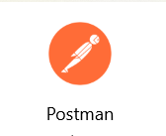




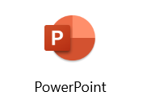


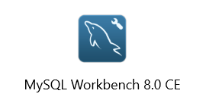
1. List of Tools used

Slide 6
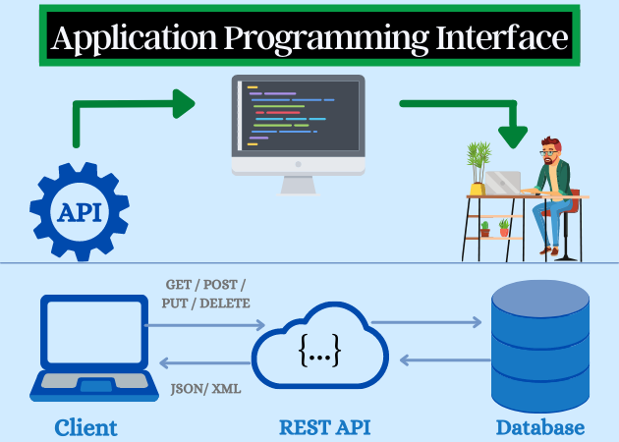
2. What is API?
An interface that can link one program to another is the API itself. In other words, the API serves as a bridge between various apps that run on the same or distinct platforms.

Slide 7
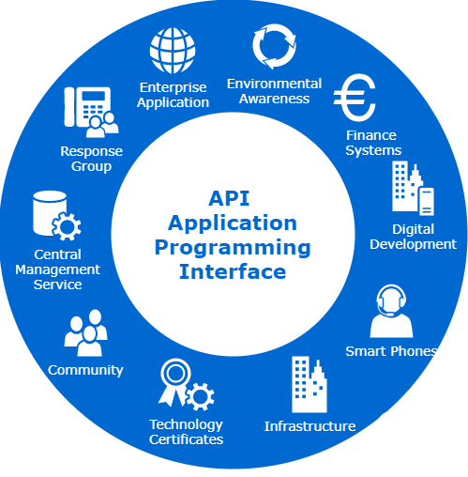
3. What is the role of API?
The purpose of an API is to give applications a standardized method of requesting resources or services from other software components without the requirement for them to comprehend the intricate details of how those components operate inside. It serves as a middleman that enables information exchange and action execution between various software systems and facilitates integration.
It serves as a middleman that enables information exchange and action execution between various software systems and facilitates integration.

Slide 8
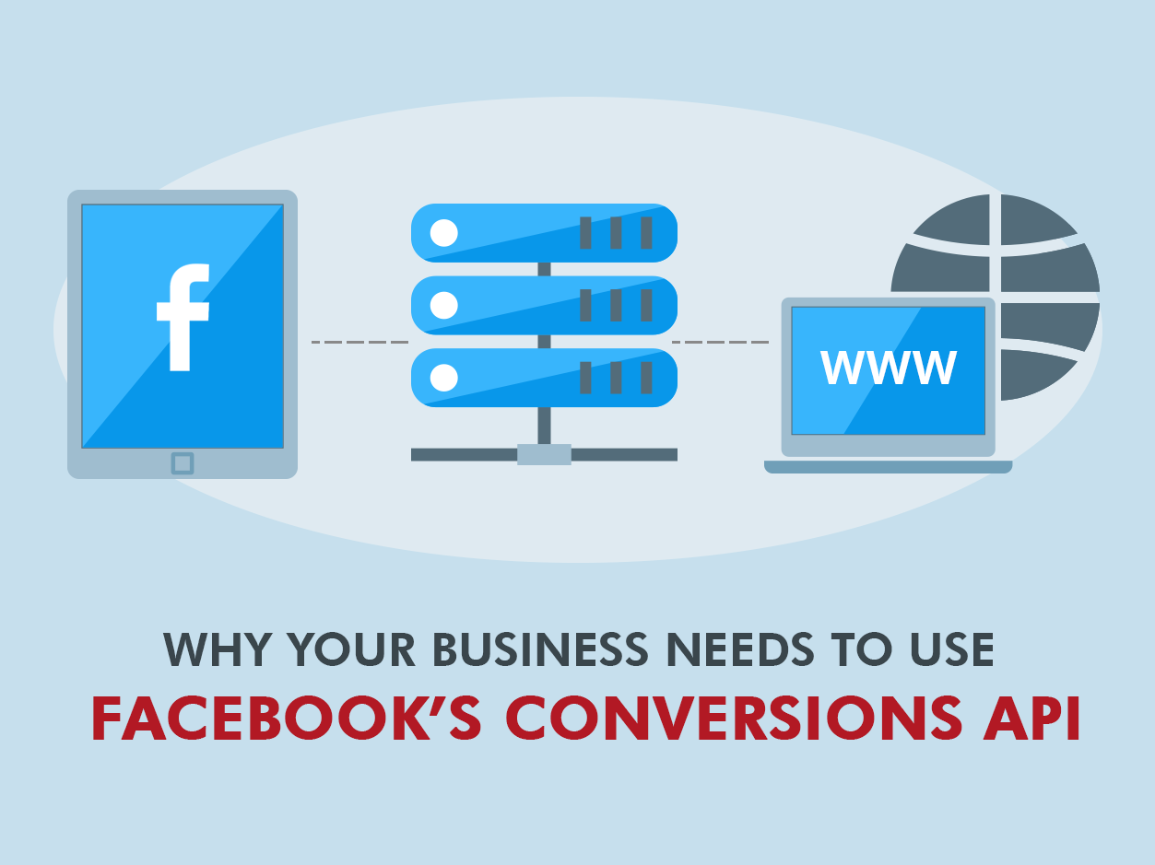
4. The range of APIs for a particular platform
Facebook Login API
Users can log on using their Facebook credentials. Due to the prevalence of Facebook accounts among users, this makes for an efficient login process. Then, since Facebook has gained popularity before other programs, it is simpler for us to create an account using the Facebook API. We may thus assume that there are many Facebook users and that using this API will be quite profitable.

Slide 9

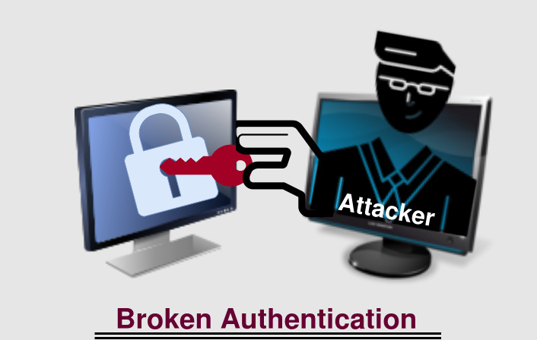
5. Potential Security Issues with APIs
Injection
Attack
Broken
Authentication

Slide 10
6. The Project Requirements
The application, can use existing APIs to log in and retrieve basic information, such as name and email from the API. Users can also register/login manually or via social login (Google / Facebook).
The Know Your Neighborhood website consists of the following main pages:
Home Page
Registration Page
Login Pages with API link
Contact us Page
About us Page
Terms and Conditions Page

Slide 11
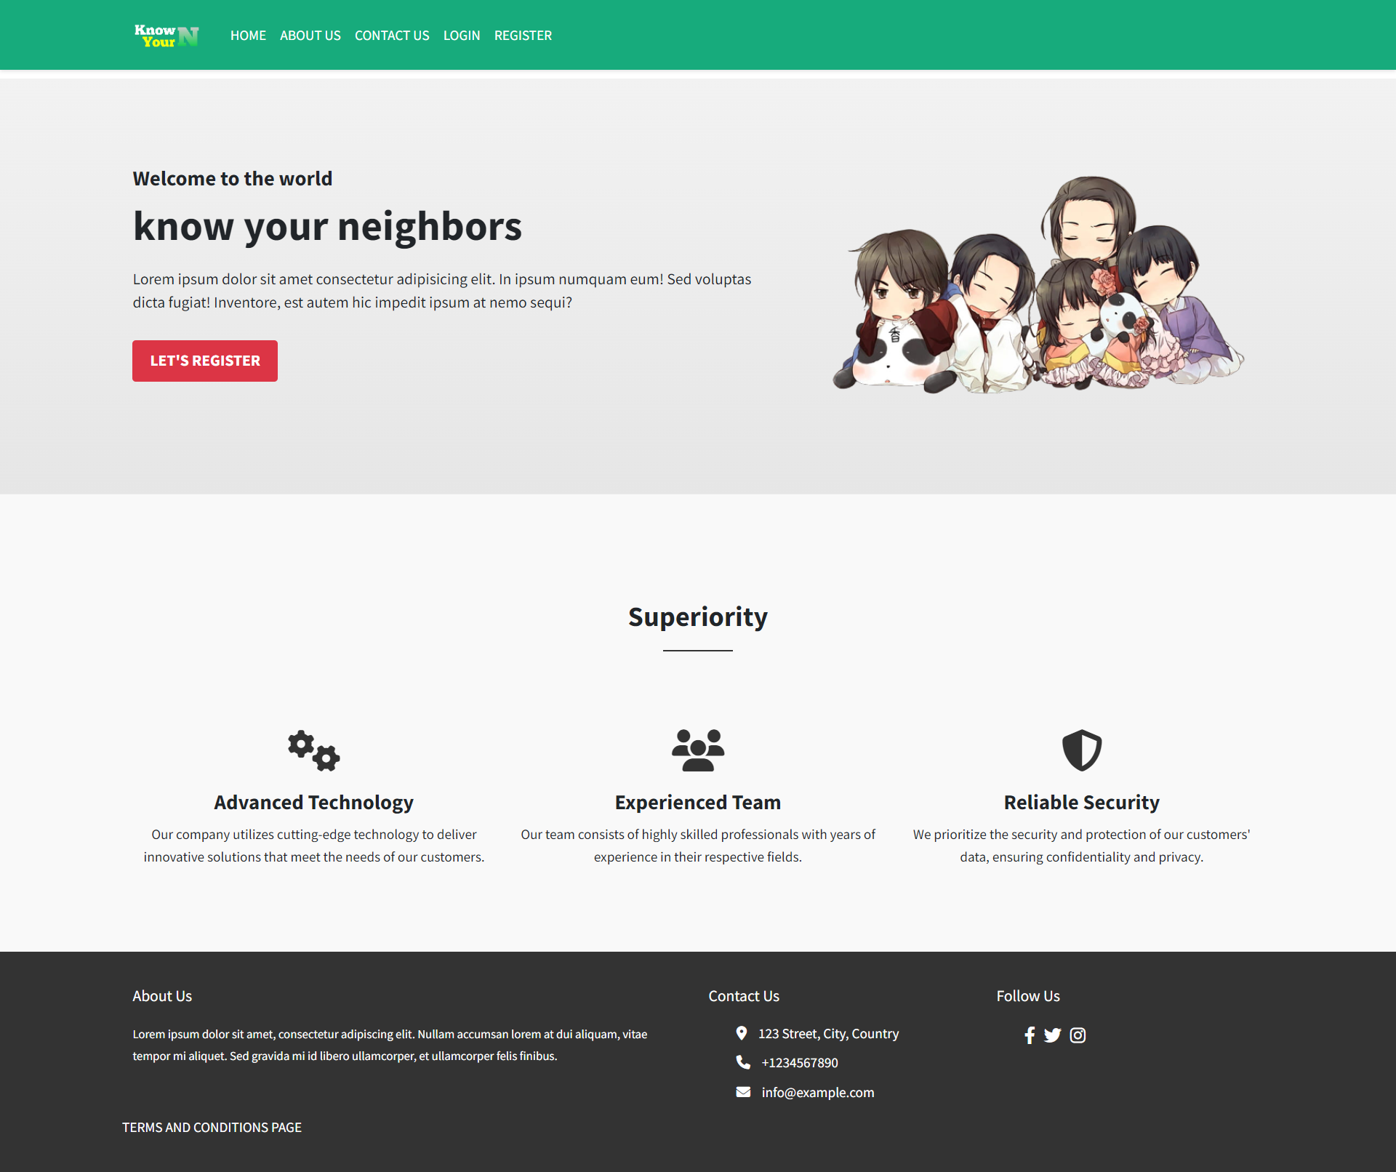
7. The Project Demo

Slide 12
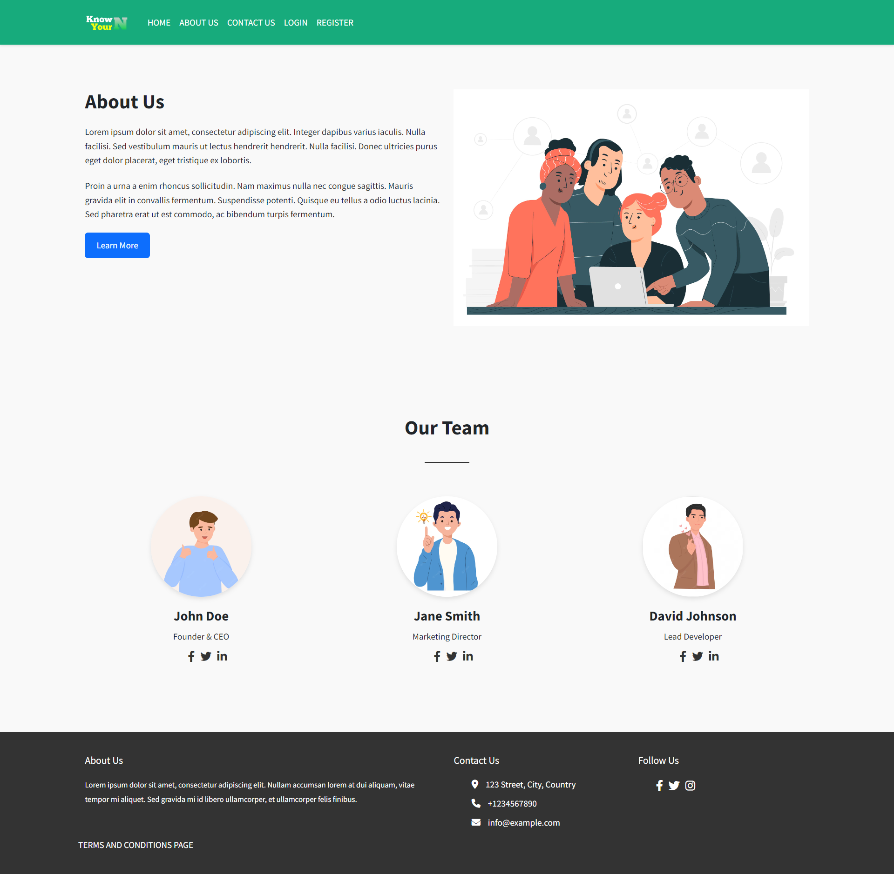
7. The Project Demo

Slide 13
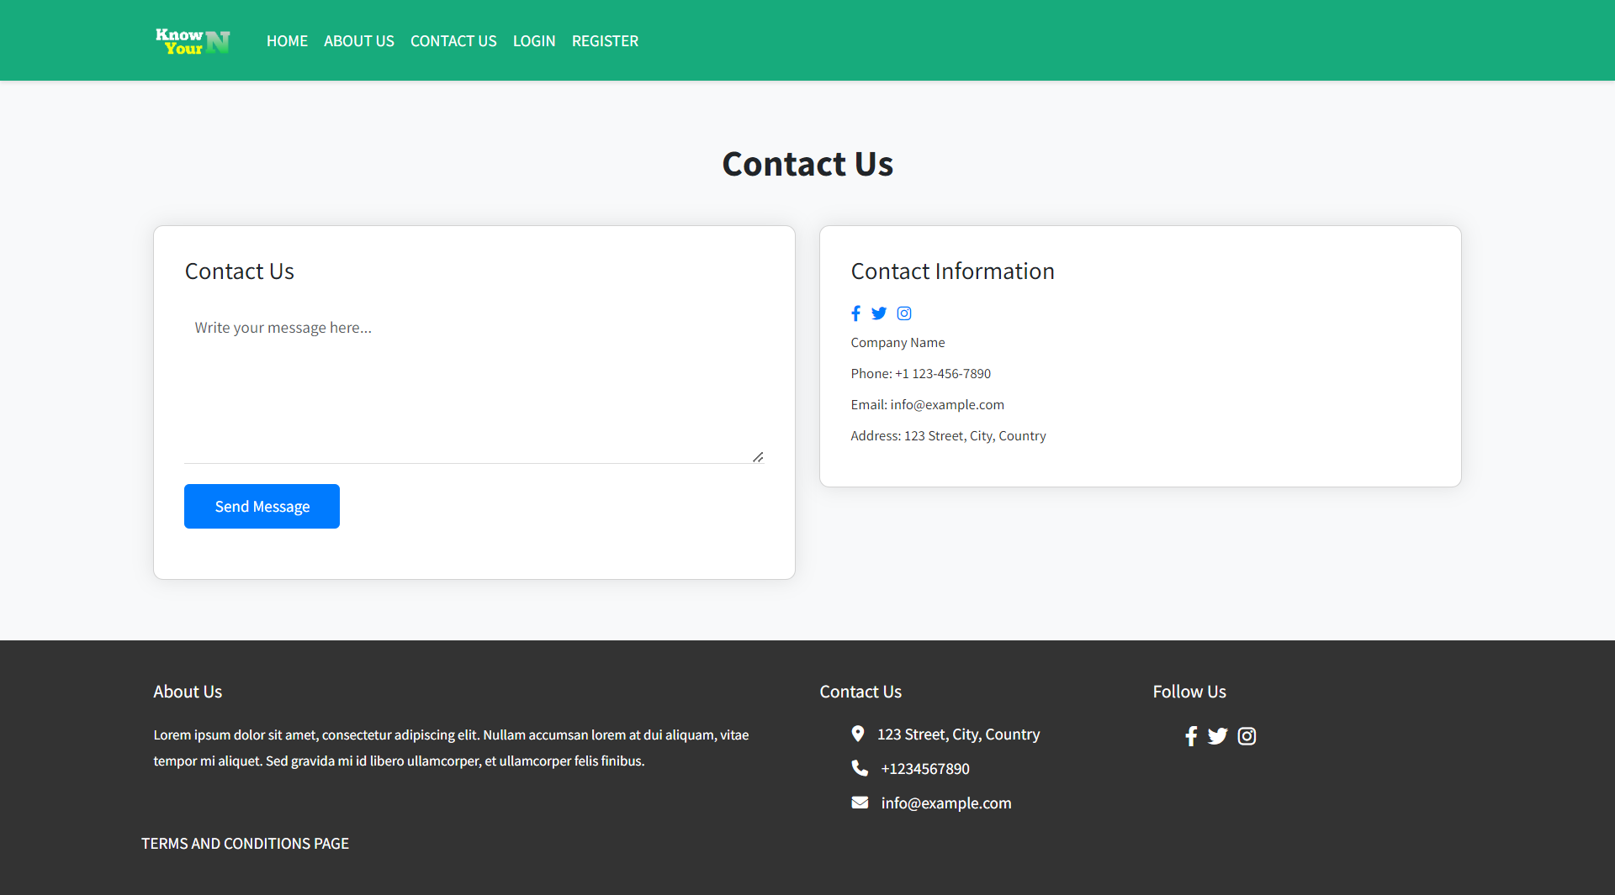
7. The Project Demo

Slide 14
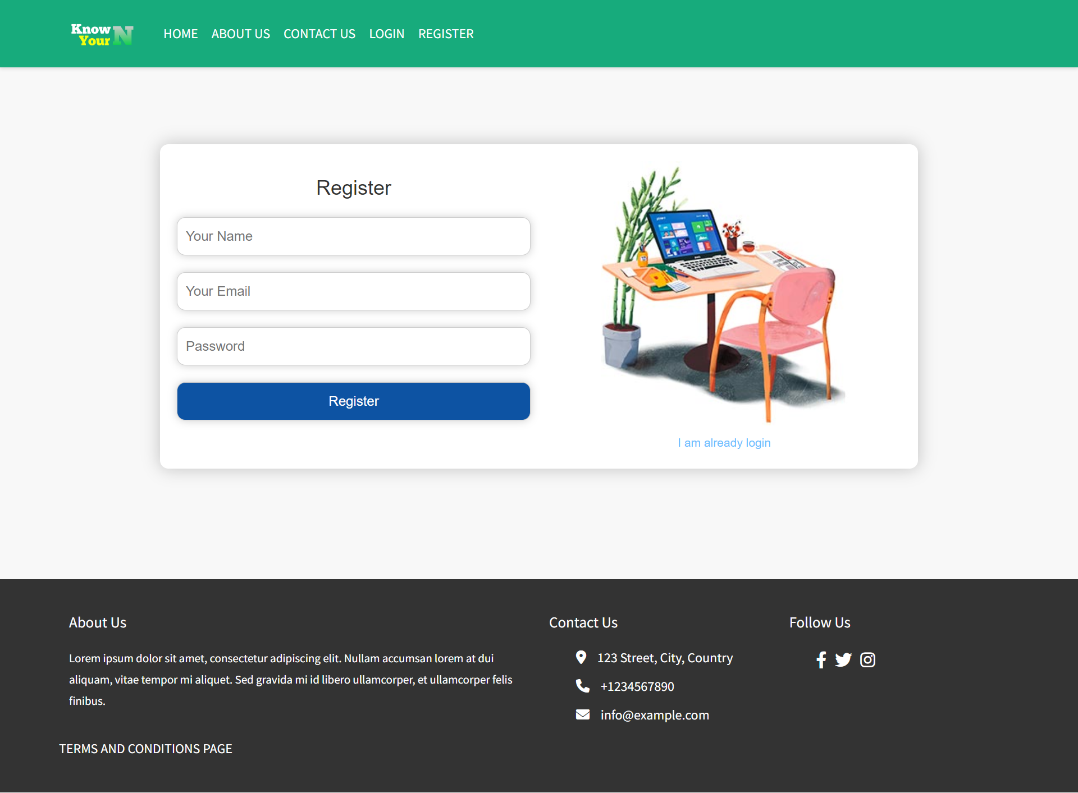
7. The Project Demo

Slide 15
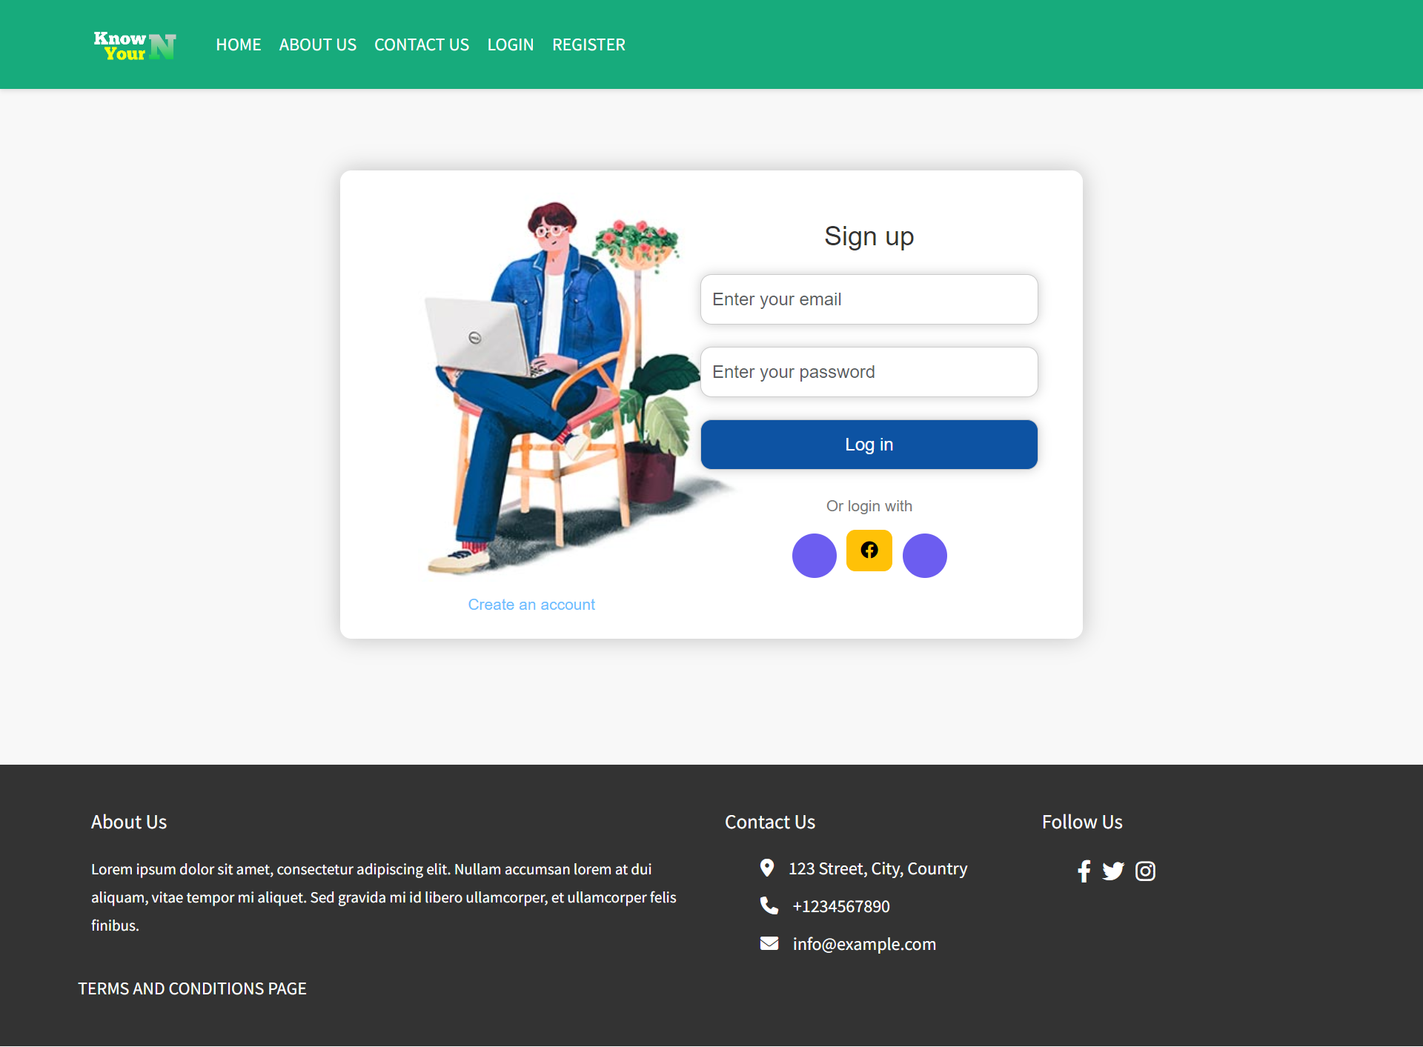
7. The Project Demo

Slide 16
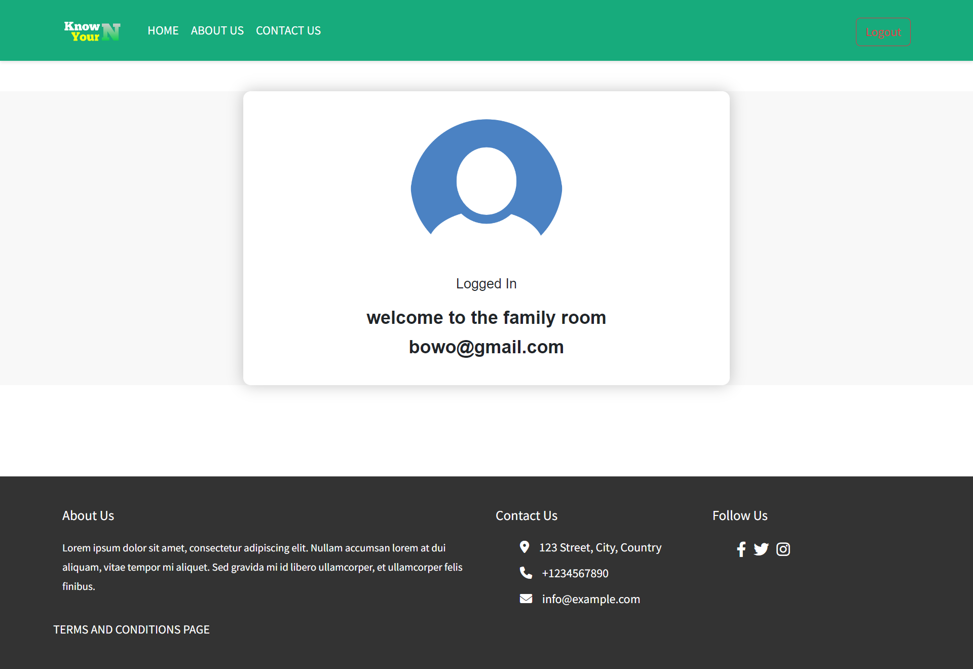
7. The Project Demo

Slide 17
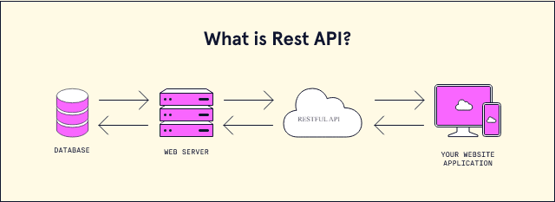
8. The Strengths of Project API
Strengths REST API
It can be used by various programming languages, including the various platforms it uses.
Simpler, especially when compared to using SOAP
Easier to learn
Like the web, which always uses HTTP in every part of it.
Android applications that use the Rest API are much faster than web view-based Android applications.

Slide 18
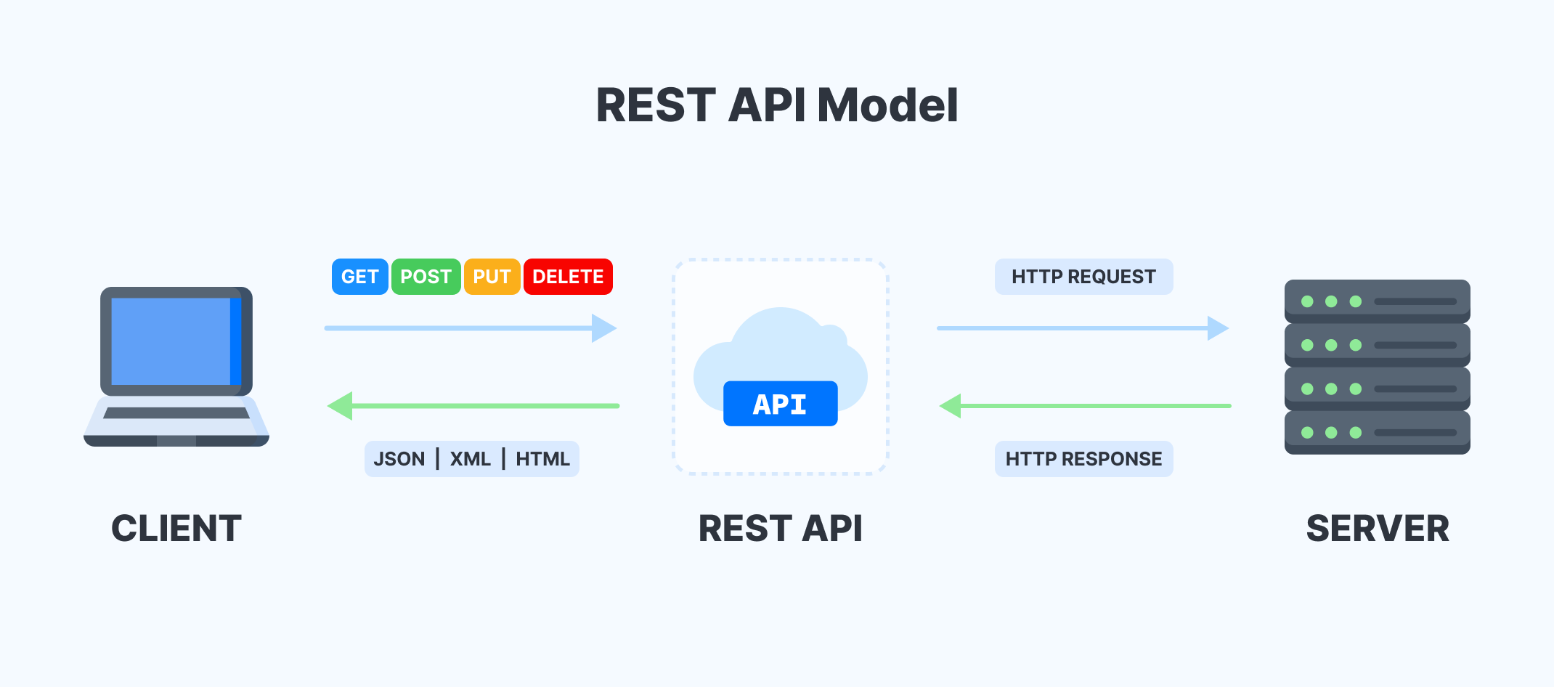
9. The Weaknesses of Project API
Weakness REST API
Usually longer access times compared to native libraries
More vulnerable to security attacks because they have to pass the HTTP protocol

Slide 19

10. Security Report
Dalam aplikasi KYN, kami menggunakan Spring Security di backend untuk mengamankan data pengguna. Langkah-langkah keamanan yang kami terapkan termasuk enkripsi kata sandi pengguna, autentikasi untuk akses tertentu, dan pengaturan CORS untuk mengontrol akses dari asal HTTP. Dengan menggunakan Spring Security, aplikasi KYN memiliki fitur otentikasi dan otorisasi yang cerdas untuk melindungi data pengguna.

Slide 20
11. Review and Reflect the application
Know Your Neighborhood application is Developed by Spring Boot for the Back End and React JS for the Front End. This App can Register Users, Login Users, Message The Developer, and log in using Facebook Account. For security purposes, we implement Spring Security. On the Database side, we use JPA Repository, and the data will store in Database in MySQL Workbench. We use BCryptPasswordEncoder to encrypt the password so the password is not easy to access.

